Slide 1

Hospital Management System
Data Modelling for Information Professionals
Group 3
Anuhya Koyyana (Team Coordinator) (11800996) : Oversaw project, ensured timely submission, created data
dictionary, Documentation- Report
Janhavi Kovelamudi (11774987) : Created and defined the database tables, applied constraints, verification of
business logic
Yogesh Meka (11787294) : Insertion of data, built the ER diagram, created database in google colab, wrote SQL
queries for data retrieval
Aaditi Dharmendra Bhandari (11785848) : Documentation- PPT, tested SQL queries for data retrieval, ensured
schema integrity

Slide 2

Objective and Scope of The project
The Hospital Management System (HMS) database is to streamline and optimize hospital operations by efficiently managing records of patients, appointments, medical histories, billing, staff information, and inventories.
The database will guarantee real-time access to patient data, optimized departmental communication, and enhanced resource management by including essential features
Health care organizations and other healthcare facilities will use this database to improve clinical and administrative processes.
Essential features including registration of patients, doctor scheduling, medicine administration, health record keeping, and financial transactions will be supported.
By ensuring accurate information, security, and accessibility, this system will reduce errors caused by humans, improve overall performance in hospitals, along with improving patient care

Slide 3
User Requirements
The system needs to create and maintain databases which hold doctor and nurse profiles showing specialization and qualifications and offering contact information.
The system needs to store contact information about an emergency contact which the system can use during urgent circumstance.
The system enables users to perform basic CRUD operations for patient record management through additional updates and deletion functions.
Basic search features shall enable the retrieval of patient, doctor and appointment information by using filters for names, IDs or dates.
The database requires NOT NULL constraints in vital fields such as PatientId, DoctorId and AppointmentId to avoid data loss.

Slide 4

Business rules:
The department needs to have an assigned doctor serving as the department head who holds unique authority over the department..
A single patient will have multiple insurance, but each insurance record will be linked to one patient.
Services cannot be booked for dates behind us.
A patient's registered emergency contact list cannot contain their own information among the contacts.
All patients need to supply at least one emergency contact during registration.

Slide 5
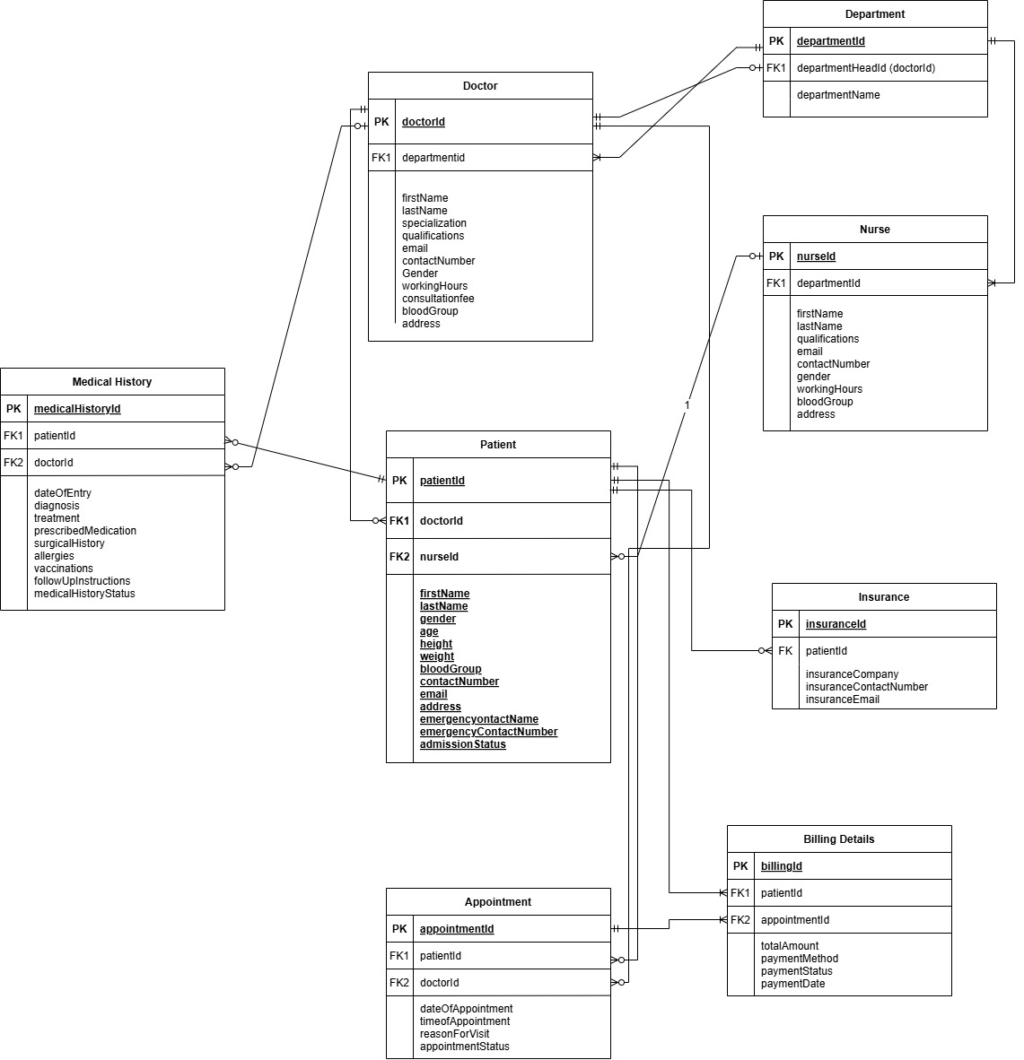
Entity – relationship Diagram (erd)

Slide 6
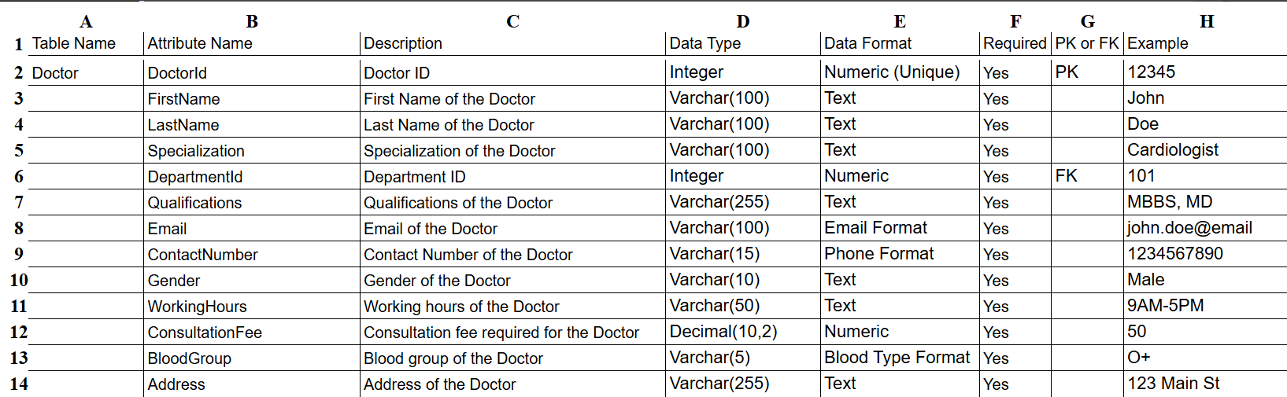
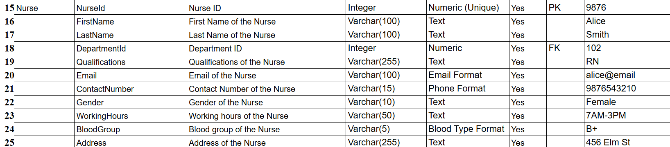
Data dictionary
Doctor Table:-
Nurse Table:-

Slide 7
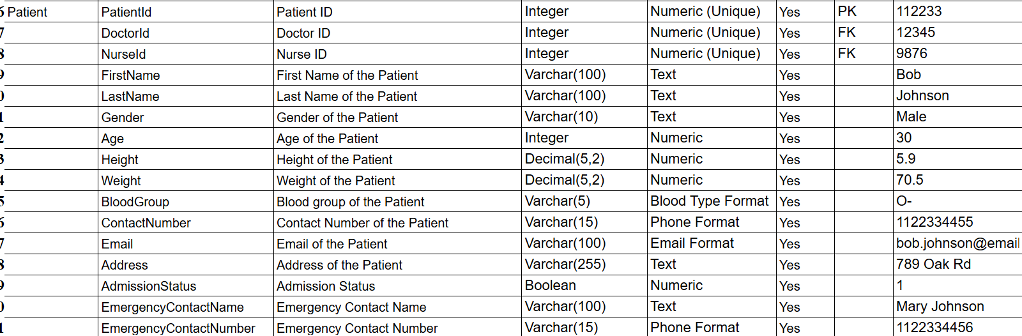
Data dictionary
Patient Table:-
Insurance Table:-

Slide 8
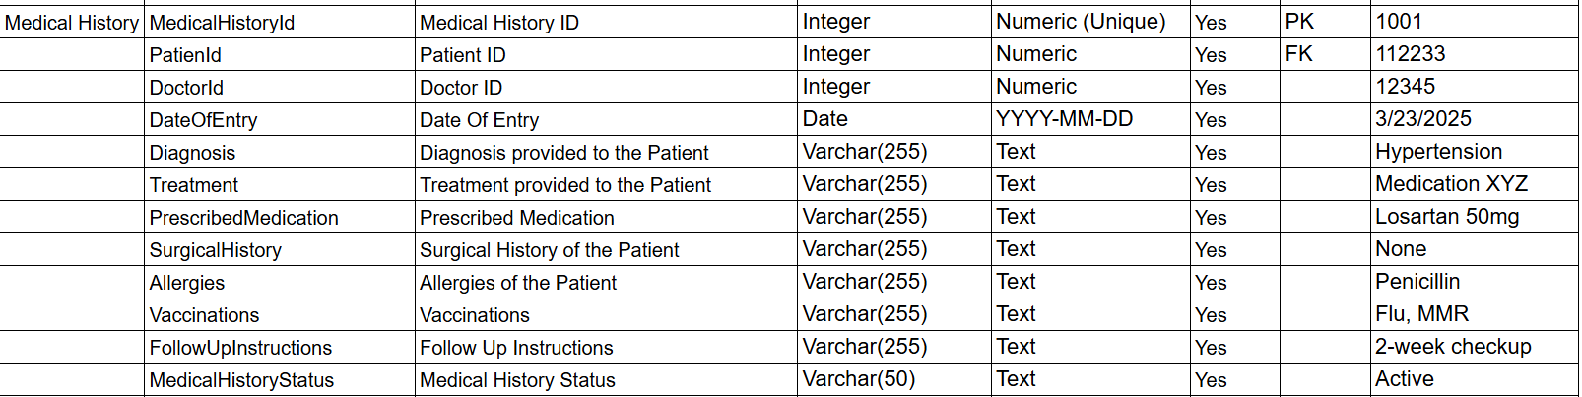
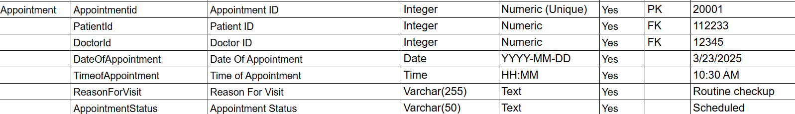
Data dictionary
Medical History Table:-
Appointment Table:-

Slide 9
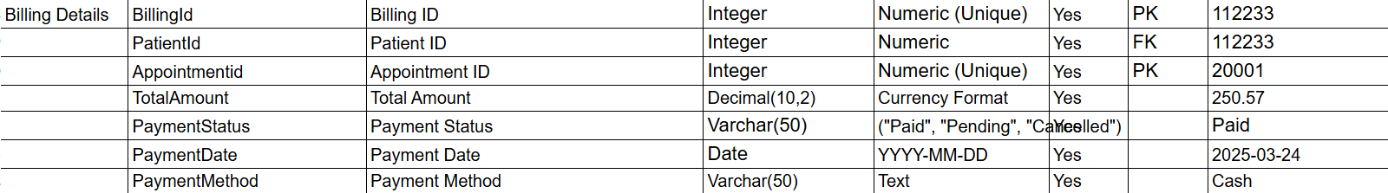
Data dictionary
Department Table:-
Billing Details Table:-

Slide 10
Live View of tables/relations in the system

Slide 11
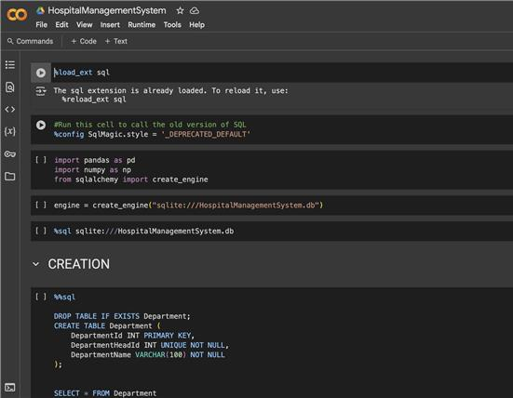
Google Colab
https://colab.research.google.com/drive/173O6h-R6vwSgYnKWHhuveLqRPWyQV2_H

Slide 12
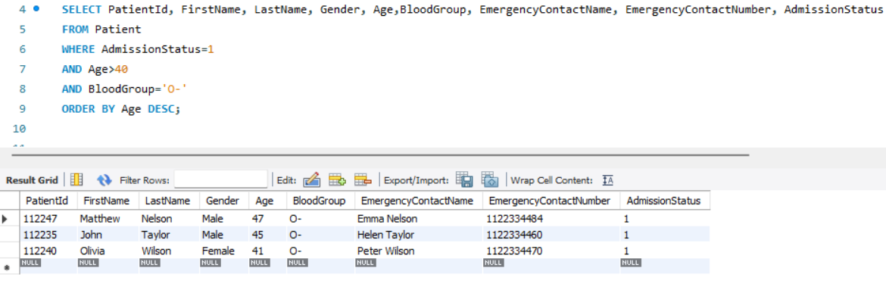
SQL Queries
Develop SQL statements to retrieve data about admitted patients over 40 years old sorted by age in descending order and displayed with gender, blood group and emergency contact details and get the list of patients with blood group 'O-'.

Slide 13
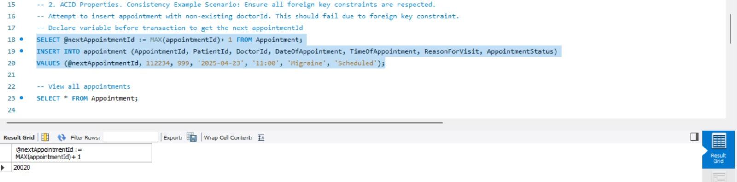
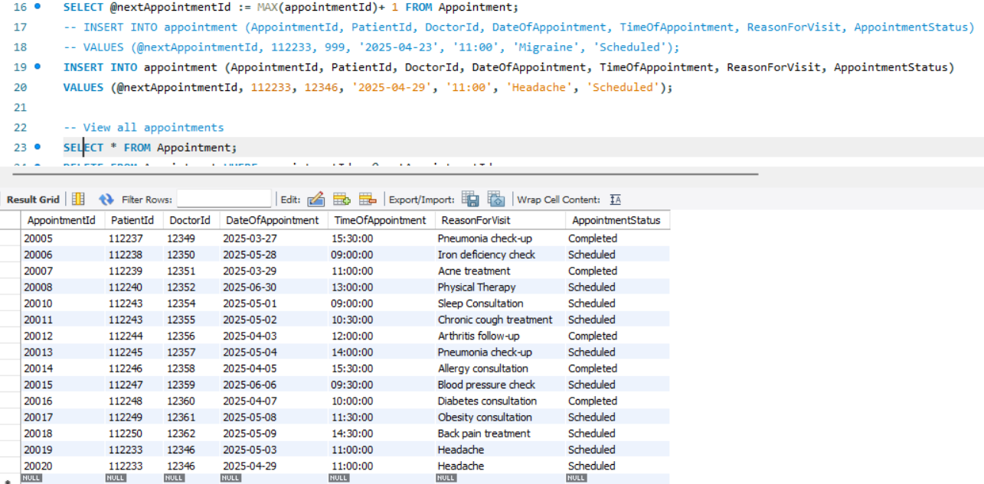
SQL Queries
Use SQL queries to define a variable for the next AppointmentId then try inserting an appointment with a DoctorId value that does not exist to test foreign key constraints while also retrieving all appointment records.

Slide 14
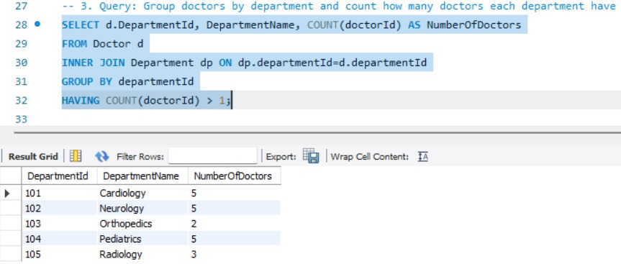
SQL Queries
Create an SQL statement that shows doctor department classifications along with the number of doctors per department only when each department contains multiple doctors.

Slide 15
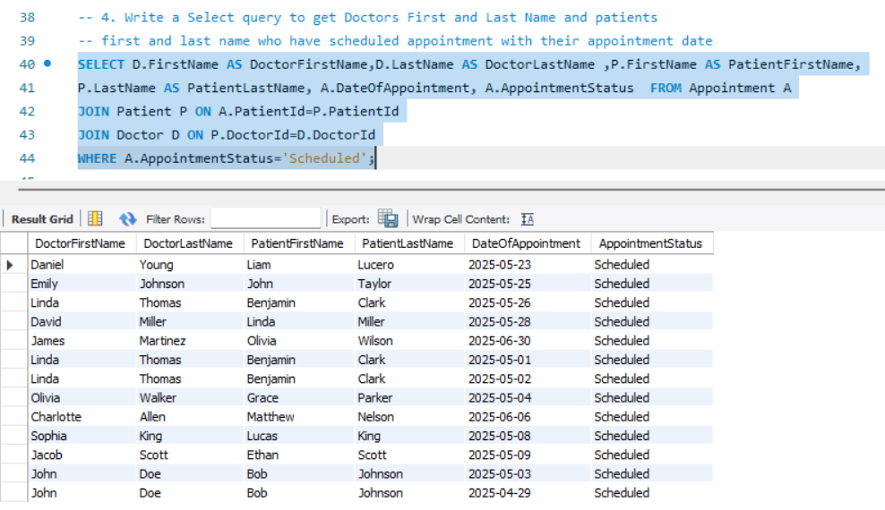
SQL Queries
Write a Select query to get Doctors First and Last Name and patients first and last name who have scheduled appointment with their appointment date

Slide 16
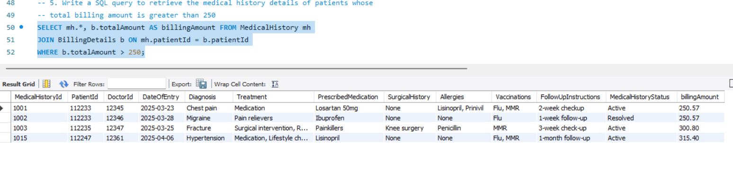
SQL Queries
Write a SQL query to retrieve the medical history details of patients whose total billing amount is greater than 250

Slide 17
THANK YOU

